Slide 1
Image Art Using Deep Learning
Presented by Aditya Thapliyal (Roll no- 2016593)
Mentor – Mr. Akshay Rajput

Slide 2
Methodology
Step 1 We import VGG 19. We will be using the intermediate layers of this model as feature detectors.
Step 2 .

Slide 3
Introduction
This project aims to use Neural Style transfer to extract style from one image and features from another image and transfer both of them to a new image all the while trying to retain the characteristics from both the images. The resulting image has the characteristics of both the original image and the style of the feature image.
So, we get our content image sort of stylized in the style of the style image.
Tensorflow model VGG19 is used to achieve this.
This technique was proposed by L.A. Gatys, Alexander S. Ecker and Matthias Bethge. They wrote a paper called A Neural Algorithm of Artistic Style back in 2015.

Slide 4
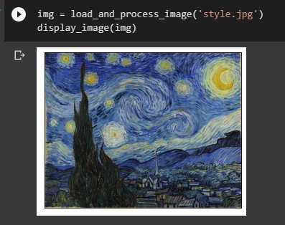
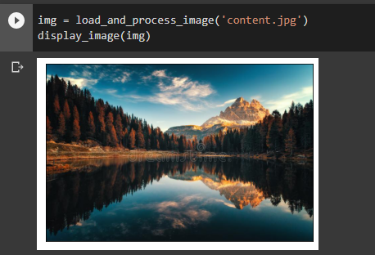

Slide 5
